Slide 1
18CSC304J COMPILER DESIGN
UNIT 5
SESSION 3, 6(a)

Slide 2
Topics that will be covered
Optimization of Basic Blocks
Building Expression of DAG
Peephole Optimization

Slide 3
OPTIMIZATIN OF BASIC BLOCKS

Slide 4
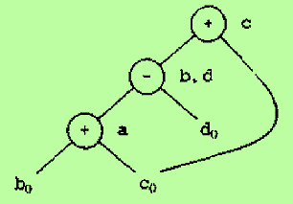
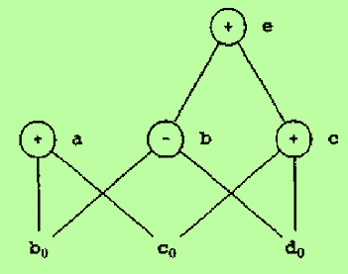
Optimization of Basic Blocks
A number of code-improving transformations such as structure-preserving transformations, dead-code elimination and algebraic transformations can be applied for basic blocks
Many of the structure-preserving transformations can be implemented by constructing a DAG for a basic block
Consider the block. The DAG for the block is
a := b + c
b := a – d
c := b + c
d := a - d
Consider the block. The DAG for the block is
a := b + c
b := b – d
c := c + d
e := b + c

Slide 5
The use of Algebraic Identities
Algebraic identities represent an important class of optimizations on basic blocks
x+0 = 0+x = x
x-0 = x
x*1 = 1*x = x
x/1 = x
2. Reduction in strength
x**2 = x*x
2.0*x = x+x
x/2 = x*0.5
3. Constant folding: Constant expressions are evaluated at compile time and the constant expressions are replaced by their values
4. Commutativity
x*y = y*x

Slide 6
The use of Algebraic Identities
5. Associativity
(x+y)+z = x+(y+z)
Sometimes, associative laws may also be applied to expose common subexpressions
Example:
Source Code
a := b + c
e := c + d + b
Intermediate Code
a := b + c a := b + c
t := c + d e := a + d
e := t + b
OR

Slide 7
BUILDING EXPRESSION OF DAG

Slide 8
DAG Representation of Basic Blocks
Directed Acyclic Graphs (DAGs) are useful data structures for implementing transformation on basic blocks
A DAG for a basic block is a directed acyclic graph with the following labels on nodes
Leaves are labeled by unique identifiers, either variable names or constants. From the operator applied to a name, we determine whether the l-value or r-value of a name is needed; most leaves represent r-values. The leaves represent initial values of names and so we subscript them with 0 to avoid confusion
Interior nodes are labeled by an operator symbol
Nodes are also optionally given a sequence of identifiers for labels. The interior nodes represent computed values and the identifiers labeling a node are deemed to have that value

Slide 9
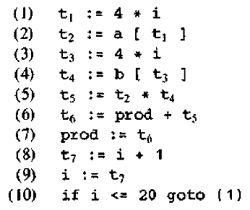
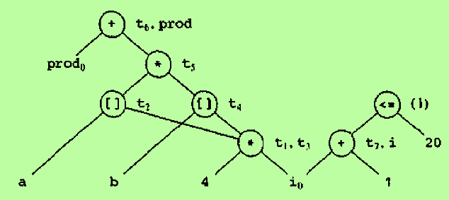
DAG Representation of Basic Blocks – cont..
EXAMPLE:
Consider the three-address code
Each node of the DAG represents a formula in terms
of the leaves
DAG

Slide 10
Algorithm : DAG Construction
Input : A basic block
Output : A DAG for the basic block containing the following information
A label for each node. For leaves, the label is an identifier and for interior nodes, an operator symbol
For each node, a list of attached identifiers
Method:
Assume that the function node(identifier) returns the most recently created node associated with identifier. Initially, we assume that there are no nodes, and the function node is undefined.
Suppose the current three-address statement is either
x := y op z
x := op y
x := y
We refer to these cases as (i), (ii) and (iii).
Relational operator is treated as case (i)

Slide 11
Algorithm : DAG Construction – cont..
Do the following steps (1) through (3) for each statement of the block
If node(y) is undefined, create a leaf labeled y and let node(y) be this node. In case (i), if node(z) is undefined, create a leaf labeled z and let that leaf be node (z)
In case (i) determine if there is a node labeled op whose left child is node(y) and whose right child is node(z). If not create such a node. Let n be the node found or created.
In case (ii), determine whether there is a node labeled op whose lone child is node(y). If not,
create such a node, and let n be the node found or created.
In case (iii), let n be node(y)
Delete x from the list of attached identifiers for node(x). Append x to the list of attached identifiers for the node n found in (2) and set node(x) to n.

Slide 12
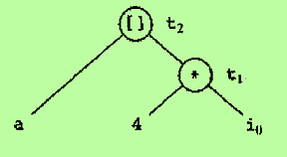
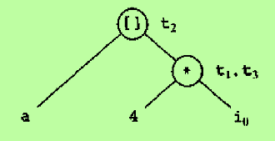
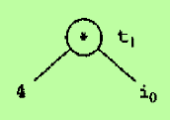
DAG Construction – Example
When t2 := a[t1] is processed,
Create a new leaf labeled a. Find the previously created node t1
Create a new node labeled [ ]. Attach the nodes a and t1 as its children
Attach identifier t2 to it
When t3 := 4 * i is processed,
Determine that node(4) and node(i) already exist
Find the previously created node * with the 2 children 4 and I
Append t3 on the identifier list for the node *
Proceed like this to construct the complete DAG
Consider the three-address statements
When t1 := 4 * i is processed,
Create leaves labeled 4 and i₀
Create a node labeled *. Make 4 as its left child and i₀ its right child
Attach identifier t1 to it

Slide 13
Applications of DAGs
Common subexpressions are automatically detected
We can determine which identifiers have their values used in the block. They are the identifiers for which a leaf is created
We can determine which statements compute values that could be used outside the block – They are exactly those statements S whose node n is constructed or found in step (2) and has node(x)=n at the end of the DAG construction, where x is the identifier assigned by statement S
A simplified list of quadruples can be reconstructed taking advantage of common subexpressions and not performing assignments of the form x := y unless absolutely necessary

Slide 14
PEEPHOLE OPTIMIZATION

Slide 15
Peephole Optimization
Peephole optimization is a simple but effective technique for locally improving the target code
It is a method to improve the performance of the target program by examining a short sequence of target instructions (called the peephole) and replacing these instructions by a shorter or faster sequence, whenever possible
The peephole is a small, moving window on the target program
The code in the peephole need not be contiguous
Examples of peephole optimization:
Redundant instruction elimination
Flow-of-control optimizations
Algebraic Simplifications
Reduction in Strength
Use of machine idioms

Slide 16
Redundant Loads and Stores
If we see the instruction sequence
(1) MOV R0, a
(2) MOV a, R0
We can delete instruction (2) if there is no label in (2), because if there is a label in (2) we could not be sure that (1) was always executed immediately before (2)
(1) and (2) should be in the same basic block for this transformation to be safe

Slide 17
1. Unreachable Code
An unlabeled instruction immediately following an unconditional jump may be removed
This operation can be repeated to eliminate a sequence of instructions
Consider the C source code shown below:
#define debug 0
…
if(debug)
{
print debugging information
}
Intermediate Representation
debug := 0
…
if debug=1 goto L1
goto L2
L1: print debugging information
L2:

Slide 18
1. Unreachable Code – cont..
One peephole optimization is to eliminate jumps over jumps
debug := 0
…
if debug≠1 goto L2
print debugging informaion
L2:
Since debug is set to 0 at the beginning of the program, the code can be replaced by
if 0≠1 goto L2
print debugging informaion
L2:
Since the argument of if statement evaluates to constant true, the code can be replaced by
goto L2
print debugging informaion
L2:
Now all the statements that print debugging aids are unreachable and can be eliminated once at a time. The code becomes
goto L2
L2:

Slide 19
2. Flow of Control Optimizations
Unnecessary jumps can be eliminated in either the intermediate code or the target code by the following types of peephole optimizations
The sequence
goto L1
…
L1 : goto L2
can be replaced by the statements
goto L2
…
L1 : goto L2
The sequence
if a<b goto L1
…
L1 : goto L2
can be replaced by the statements
if a<b goto L2
…
L1 : goto L2
2
1

Slide 20
2. Flow of Control Optimizations – cont..
Suppose there is only one jump to L1 and L1 is preceded by an unconditional goto. Then the sequence
goto L1
…
L1 : If a<b goto L2
L3 :
can be replaced by the statements
if a<b goto L2
goto L3
…
L3 :
Though the number of instructions in both the sequence is the same, we sometimes skip the unconditional jump goto L3 in (2), but we cannot skip any jump in (1)
Thus (2) is superior to (1) in execution time
3
(1)
(2)

Slide 21
3. Algebraic Simplification
Many algebraic simplifications can be attempted through peephole optimization
A few of them occur frequently
For example, statements such as x := x + 0 and x := x *1 are often produced by intermediate code generation algorithms. They can be eliminated through peephole optimization

Slide 22
4. Reduction in Strength
Reduction in strength replaces expensive operations by equivalent cheaper ones on the target machine
For example, it is cheaper to implement x² as x*x than as a call to an exponentiation routine
Fixed-point multiplication or division by a power of two is cheaper to implement as a shift
Floating point division by a constant can be implemented as multiplication by a constant

Slide 23
5. Use of Machine Idioms
The target machine may have hardware instructions to implement certain specific operations efficiently
Detecting situations that permit the use of these instructions can reduce execution time significantly
For example, some machines have auto-increment and auto-decrement addressing modes
The use of these modes greatly improves the quality of code when pushing or popping a stack
These modes can also be used in code for statements like i:=i+1 or i:=i-1

